Slide 1
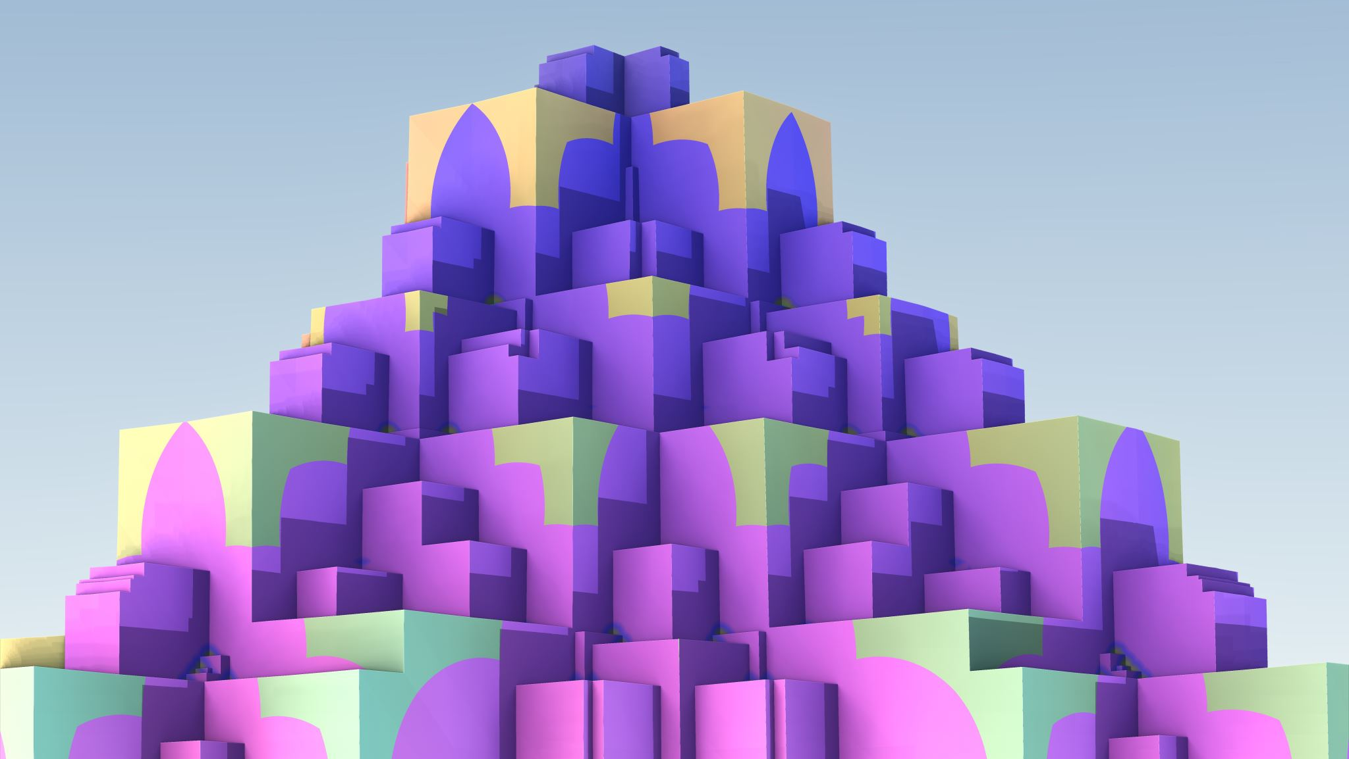
Praxis Approach
Design

Slide 2
LLM Approach
Document
Window
Window
Document
LLM
LLM
LLM can process the entire document or documents within its window
LLM can only process a subset of the document or documents within its window

Slide 3
Proposed Approach
Document
Partition Document into Chunks
Chunks
LLM
Knowledge Graphs
LLM
Grouped Knowledge Graphs
Process Chunks into one Knowledge Graph per Entity
Identify type of each entity and group together

Slide 4
Proposed Architecture
D – Data
KG – Knowledge Graph
L – LLM
P – Prompt
(KG2)
Long-Term Memory
(L3)
Memory
(D1)
Documents
Out of scope
(P2)
Long Term Memory Formation
(P4)
Long Term Memory Processing
(P1) Document Processing
(P5)
Response
(L2)
Memory Formation
(L4)
Response Processing
(L1)
Input Processing
(P3)
Query
(KG1) Short-Term Memory

Slide 5
Notes
What is the validation?
Introduce errors to measure how well it does
Introducing errors into documents.
Start with smaller documents.
Partition the document.
Errors within a partition
Errors between partitions
Metrics
Number of chapters
Number of words
How many pages are processed
How long does it take?
How well does it scale?
Top non noise words
To do
Continue Research – focus is on Knowledge Graphs
Continue Methodology
Update chapter 1

Slide 6
Data Definitions
ID | Item | Use | Notes
D1 | Documents | Word documents stored and ready for use.

Slide 7
Knowledge Graph Definitions
ID | Item | Use | Notes
KG1 | Short-Term Memory | Consolidation of knowledge graphs from all input processing. | I am not sure if it is one graph, one graph per input, or one graph per type. I am not sure how to store it. How do I relate back to the document?
KG2 | Long-Term Memory | Consolidation of knowledge graphs from all processing. | I am not sure if it is one graph, one graph per input, or one graph per type. I am not sure how to store it.

Slide 8
LLM Definitions
ID | Item | Use | Notes
L1 | Input Processing | A pre trained LLM. Not specific to this task. | Probably overkill. A future direction would be to have an LLM that specifically knows how to do this task.
L2 | Memory Formation | A pre trained LLM. Not specific to this task. | Probably overkill. A future direction would be to have an LLM that specifically knows how to do this task.
L3 | Memory | A pre trained LLM. Not specific to this task. | Probably overkill. A future direction would be to have an LLM that specifically knows how to do this task.
L4 | Response Processing | A pre trained LLM. Not specific to this task. | Probably overkill. A future direction would be to have an LLM that specifically knows how to do this task.

Slide 9
Prompt Definitions
ID | Item | Use | Notes
P1 | Document Processing | Process one document at a time. Using a prompt like: Process this document into a knowledge graph and assign attributes to each entity. There should be a type hierarchy. A first cut of the type should be done by looking at the Long-Term Memory. | Each run add one or more knowledge graphs into the short-term memory. A first cut of the type is assigned. It needs to store the source with the knowledge graph.
P2 | Long Term Memory Formation | A prompt like: Review the knowledge graph in the short-term memory and integrate it into the long-term memory resolving any duplicates and consolidating into a consistent type hierarchy. | The knowledge graphs in the short-term memory are consolidated into the long-term memory. They are then removed from short term memory. This is run periodically. Could be when input is quiet for a period or every hour.

Slide 10
Prompt Definitions
ID | Item | Use | Notes
P3 | Query | A general LLM prompt. Can include references to Long-Term or Short-Term memory. The prompt is augmented to store the prompt in the short-term knowledge graph.
P4 | Long Term Memory Processing | A prompt like: Review all nodes of the knowledge graphs and look for ways to improve them by creating new edges, adding attributes, making similar things similar. Replace with the better version. | Runs once a day to keep the long-term memory well organized.
P5 | Response | An agent that reviews the short-term memory looking for things that it can respond to. Uses a prompt like: Review the short-term memory and look for items that you can respond to. Use the long-term memory if needed.

Slide 11
Processing Steps
Load
Load up one or more documents
Start
Start the document processing (How?)
Wait
Give it time for background processes to work
Query
Issue prompts to ask questions

Slide 12
Notes
Which LLM should I use?
What structure should the knowledge graph be? I am thinking XML.
How can I make the knowledge graph more like a Frame with Slots?
Should the knowledge graph be stored in OS files or a structured storage mechanism?
I would like to store everything in a Neural Network. Could be a future direction.

Slide 13
Future Directions
Create task specific LLMs
Store Knowledge Graphs in Neural Networks
Make Knowledge Graphs into Frames

